Slide 1
Practical lesson № 7
Pharmacotherapy in nursing practice

Slide 2
Control questions
Pharmacotherapy, medication. Definition.
Types of pharmacotherapy: Etiotropic, Pathogenetic, Symptomatic, Substitution, Preventive therapy.
Basic knowledge regarding drugs, which should have a nurse.
Effects of drugs on the body: Therapeutic Effects, Local Effects, Systemic Effects, Side Effects.
Definition of the medical terms: «dose», «minimum dose»,«maximum dose», «Lethal dose».
Methods of drug administration:External, Enteral, Inhalation, Parenteral administration.
External administration. Definition.Formsof drugs. Advantage and Disadvantages.
Enteral administration. Definition. Types of enteral administration. Formsof drugs. Advantage and Disadvantages.
Inhalative administration. Definition. Types of Inhalers. Advantage and Disadvantages.
Parenteraladministration. Definition. Methods of the parenteral administrat. Advantage and Disadvantages.
Syringe. Classificationof syringes.
Intradermal Injection. Definition. Purpose. Site of injection.
Subcutaneous Injection. Definition. Site of injection.
Intramuscular inject. Definition. Site of injection.
Intravenous injection. Definition. Site of injection. Factors complicating intravenous injection.

Slide 3
Pharmacotherapy - treatment with drugs or pharmacological agents.
A medication is a substance administered for the diagnosis, disease, cure, treatment, or relief of symptom or for prevention of disease.

Slide 4
Therapeutic Effects
It is the effect which is desired or the reason а drug is prescribed. Therapeutic effects are the medication's desired and intentional effects.
Side (Adverse) Effects
Adverse effect is аny effect other than the therapeutic effect.
Some adverse effects are minor, whereas some other mау cause very serious health problems. Adverse effects mау bе morе in а very seriously ill client or а client who receives moге medications.
Local Effects
Local effects of а drug аге expected when they аге applied topically to the skin or mucus membrane.
Systemic Effects
А drug used for systemic effect must be absorbed into the blооd stream to produce the desired effect in the various systems аnd parts of the body.
These effects vary with the nature of medications, the length of time the client has been receiving

Slide 5
Preventive therapy – is carried out for the prevention of disease.
TYPES OF PHARMACOTHERAPY:
Etiotropic therapy.
This type of therapy eliminates the cause of disease. This is the ideal type of pharmacotherapy.
Pathogenetic therapy
is aimed at elimination or suppression of mechanisms of the disease.
Symptomatic therapy
is aimed at the elimination or restriction of specific manifestations of the disease.
Substitution therapy
is used at the deficit of natural nutrients. Means of substitution therapy include enzymes for pancreas (pankreatin, panzinorm and others).

Slide 6
METHODS OF DRUG ADMINISTRATION:
1. External administration
2. Enteral administration
Sublingual,
Buccal,
Oral
Rectal
3. Inhalation administration
4. Parenteral administration

Slide 7
External administration – is the use of drugs to the skin and mucous membranes
Advantage of external administration:
- Ease of use
- Direct effect on lesion focus
- Reduced side effects
Disadvantages of external administration:
- only for local effect.

Slide 8
Enteral administration –
is the introduction of drugs through the gastrointestinal tract.
Types of enteral administration:
- Through the mouth (oral),
- Under the tongue (sublingual)
- To cheek (buccal administration)
- Through the rectum (Rectal)

Slide 9
Advantages of enteral administration:
Most convenient
Usually least expensive
Many different forms
Does not break skin barrier (safe)
Administration usually does not cause stress
Rapidly dissolve on the tongue (allowing for faster absorption and action)
Systemic effect

Slide 10
Disadvantages of enteral administration:
Inappropriate for clients with nausea or vomiting
Drug may have unpleasant taste or odor
If client cannot swallow or is unconscious
Cannot be used before certain diagnostic tests or surgical procedures
Drug may discolor teeth, harm tooth enamel
Slow absorption
Partial destruction in the gastrointestinal tract by the action of digestive juices
Limitation of the admission in case of emergency

Slide 11
Inhalative administration
- the administration of drugs through the respiratory tract by inhalation (breathing).
Advantage of the Inhalative administration:
Introduces drug throughout respiratory tract
Rapid Local effect
Drug can be administered to unconscious client
Drug has a therapeutic effect even in minimal doses Risk of side effects is reduced
Disadvantages of the Inhalative administration:
Local effect
Of use only for the respiratory system

Slide 12
The parenteral administration
Parenteral method - the introduction of drugs avoiding the gastrointestinal tract.
Advantages of parenteral administration:
Rapid effect («on the needle»)
Dosing accuracy
Delivery of the drug into the bloodstream unchanged
Disadvantages of parenteral administration:
well-trained staff is required
compliance with aseptic and antiseptic is required
Breaks skin barrier

Slide 13
Methods of the parenteral administration
In the tissue: intradermally, subcutaneously, intramuscularly, intraosseously.
In vessels: intravenously, intraarterially, in lymph vessels
In the cavity: the pleural cavity, the abdominal cavity, intracardiac, into the joint cavity
In the subarachnoid space.

Slide 14
Systems of Medication Distribution in hospitals
Four types of systems аге used to ensure the safe storage and administration of medications.
1. The stock supply.
2. The unit dose supply.
3. The automated medication dispensing system.
4. The self-administered supply.

Slide 15
Stock Supply
In this system large quantities of frequently prescribed medications are provided in а client care area, which are stored in locked cupboard in а storage room. Individual doses are administered to clients, in that particular unit by nurses who measure individual doses from the large stock bottles on packaged containers. Narcotic drugs are supplied by this system.

Slide 16
Unit Dose
In this system the pharmacy оr manufacturer does the prepackaging оr prelabelling of the individual client dose. The individual unit dose is а prescribed amount of medication dispensed at а specified time. In this system pharmacists and nurses both participate in preparation and administration of medication and evaluating their effects. In large health care facilities this is the preferred system because it provides а double check mechanism ensuring client safety. Besides this, the pharmacist сan provide information to the nurse regarding medication, interaction and contraindications. It also saves the vаluablе nursing time.

Slide 17
Automated Medication Dispensing System
These machines usually contain а combination of medications frequently used in а unit (so that newly ordered medications сan be immediately administered) PRN medications, controlled drugs, and emergency medications. Nurses can access the system by using а password, then select а function from choices offered by the computerized menus to obtain the desired medication for clients. This system helps to keep an account of all medications used for billing and controlled substance for record keeping.

Slide 18
Self-Administered medications (SAM) System
In this, each client is supplied with his/her prescribed doses and quantities for а given period. Each medication is supplied in а separate container and is used only for оne client medication. It can be stored at the client's bedside, sо as to еnаblе self-administration. This system gives opportunity for the client to get involved in his / her own care. It also saves the nurse's time in administering medications.

Slide 19
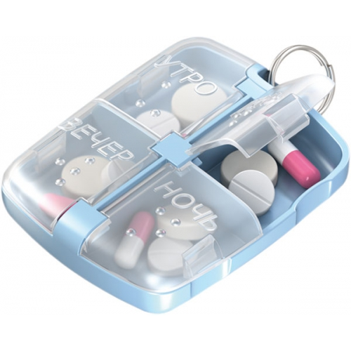
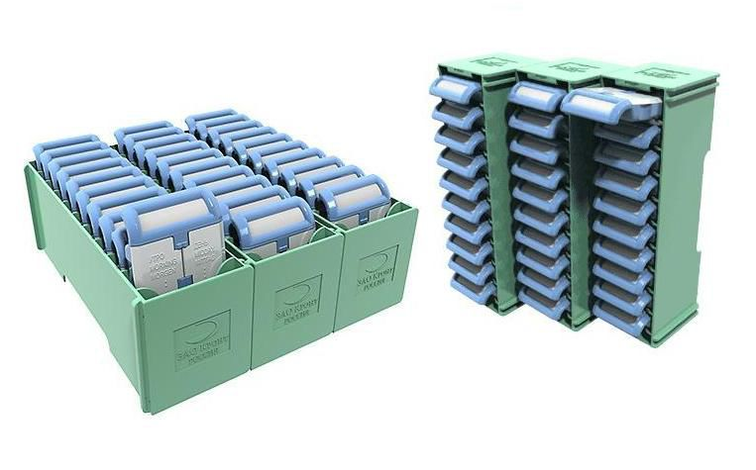

Slide 20
Storing of Medicines Care of Medicine Cabinet and Drugs
To stock the medicines, each ward should be provided with a medicine cabinet.
It should be large enough to accommodate all drugs to be stocked in ward
As far as possible, the medicine cabinet should be kept in a separate room adjacent to the nurse's room.
A washing sink with running water should be provided in that room for hand washing facilities.

Slide 21
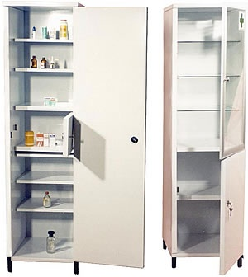
5. Adequate lighting should be provided within the cabinet to read the labels clearly.
6. There should be separate compartments for different categories of drugs - for mixtures, tablets, powders etc.
7. Drugs used for external use should be kept separate from the drugs used for internal use.
8. The containers should be arranged alphabetically, so that it is easy to find them.

Slide 22
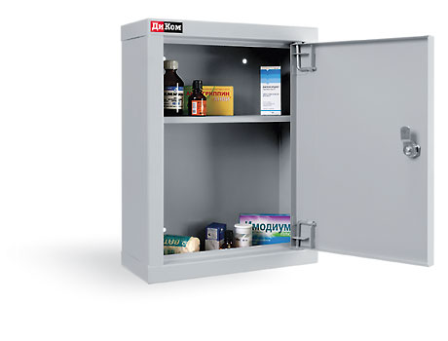
9. Poisonous drugs should be kept in a separate cupboard which must have separate lock and key.
10. A senior nurse should be responsible for the poisonous medicines in the cupboard.
11. A register should be maintained to keep the account of the poisonous drugs.
12. A daily inventory should be taken to prevent theft of narcotics.
13. All the poisonous drugs should be marked «poison» in red ink.

Slide 23
14. No drug should be stored without labels, even for a day. All the containers should have labels written neatly and legibly. The labels should contain the name of the drug, the ingredients, the strength, the dose etc.
15. All medicine containers should be kept closed always. The containers keeping the capsules, alcoholic preparations, volatile drugs etc., should have airtight caps. The tablets and pills tend to disintegrate if exposed to air.
16. The drugs that are unusual in colour, odour and consistency should be returned to the pharmacy and replaced with fresh ones.

Slide 24
17. Check the expiry date every drug and make use of it before its expiry date is over or send it to dispensary and get it replaced.
18. The drugs which are destroyed in the room temperature such as vaccines, sera, antibiotics etc., should be kept in the refrigerators.
Emergency drugs should be kept in place where they are readily obtainable for emergency use.
20. When indenting for drugs, indent only should the required quantity: the request for new supply of medicines should be signed by the ward sister. All medicines should be checked and signed as they are received from the dispensary.
21. The medicine cabinet should always be kept neat and clean and all equipments should be kept clean and dry after their use.

Slide 25
22. The medicine cabinet should always be kept locked and the key should be kept where only doctors and nurses have access to it.
The oily medicines should be kept in a separate tray or on a piece of waterproof paper to prevent soiling the shelf. Special oil cups or spoons are used which are helpful in keeping the oily odours away from medicine glasses.
Drug therapy is one of the most important therapeutic measures. The success of treatment depends on skilled and competent use of medicines.

Slide 26
Make a note about the intake of the drug in the medical record - “done".
It is very important for the doctor to correct drug therapy.

Slide 27
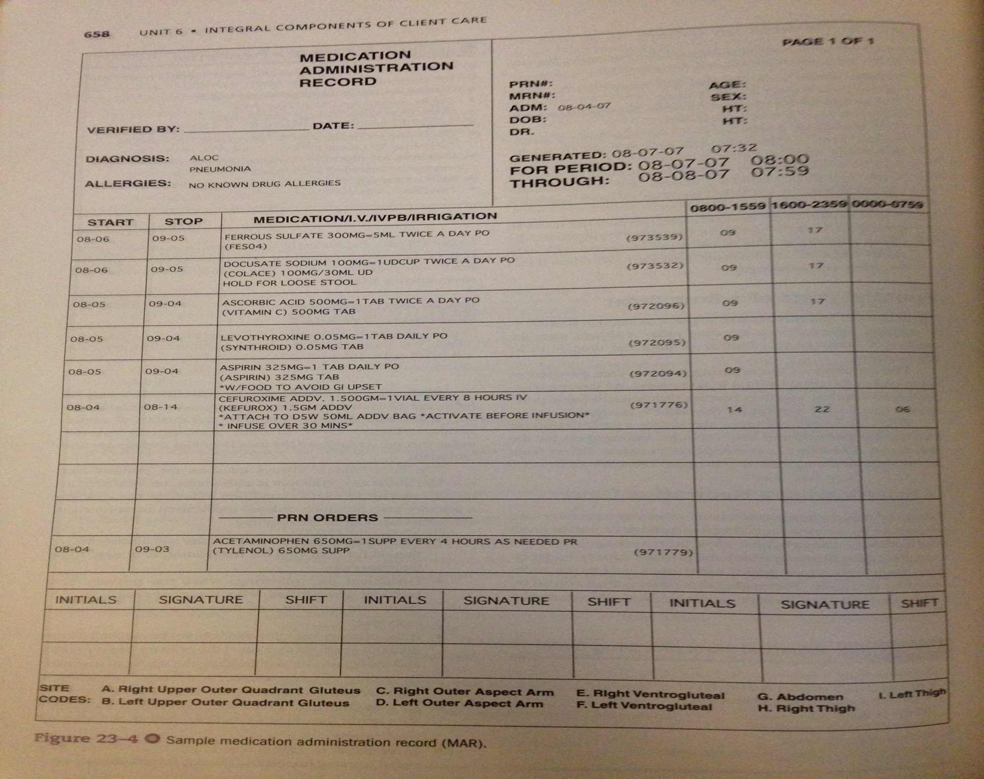

Slide 28
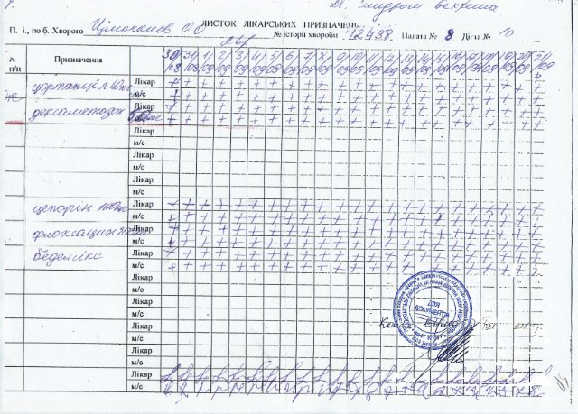

Slide 29
Sources of lnformation About Medications
special professional literature (Printed Materials)
Computer-Based Resources
People (Physicians, nurses, pharmacists).

Slide 30
The nurse administering medication should have the basic knowledge regarding drugs which include the following:
1. Name of the drug.
2. Classification.
3. Route and time of administration.
4. Principles of drug action.
5. Dosage.
6. Medication standards.
7. Types and forms of drugs.
8. Sources of information about medication.
9. System of medication distribution.
10. Medication order.
11. Prescription and non-prescription medication.
12. Weights and measures used.

Slide 31
13. Preparations of solution and calculation of fractional doses.
14. Storing of medications.
15. Factors affecting safety in the administration of medications.
16. Abbreviations and symbols used.
17. Rules for administration of medicine.
18. Legal aspects of medication administration.
19. Nurse practice acts.
20. Institutional medication policies.
21. Client's rights.
22. Substance abuse.
23. Nurse's role in administration of medication.

Slide 32
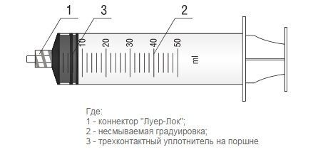
Давайте рассмотрим различные виды шприцов. Let's look at the different types of syringes.
To perform the injections you need special equipment - syringes and needles
Syringe - a tool in the form of a hollow graded cylinder with a plunger of delivery or suction of liquid.

Slide 33
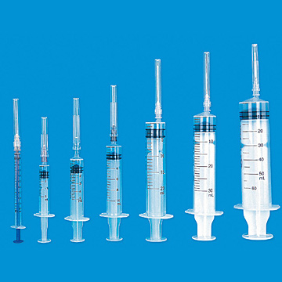
Modern syringe was invented by veterinarian Charles Gabriel Pravaz and Alexander Wood (independently) only in the 1853.
Currently, syringes are made ​​of PVC intended for single use. Syringes are manufactured and sterilized in factory conditions and produced in a sealed package.

Slide 34
Currently, many inventors are working on the idea of really disposable syringes. This problem is due to fight the spread of HIV and other infections. Some inventors have already achieved success. Self-locking syringes - are syringes with a plunger which gets blocked after use. This syringe can not be used for a second time.

Slide 35
Syringes medical tools used for injection, diagnostic puncture, or aspiration pathological content of the cavities of the human body.
Classification of syringes:
1. Disposable syringes
Standard: 2 ml, 3 ml, 5 ml, 10 ml, 20 ml, 50 ml
Nonstandard: Insulin syringes, Syringe Janet, Auto-disable syringes, syringe-tube
2. Reusable syringes
Syringe-pen
Dental syringes
Syringe -gun

Slide 36
Preparation medicines (take out from an ampule)
Equipment. Sterile: disposable syringes, 2 needle, tray, 3-4 napkins or cotton swabs (balls). Antiseptic (70% spirit), container for disinfection / disposal of used material (waste class A, Б).
Algorithm of actions:
Wash hands. Wear gloves.
Select the medication. Read the physician's order from medicine card. Compare the label of the medicine with the medicine card and physician's orders. Calculate the dosage of the medication, the amount of the solvent to be to obtain the required dosage.
Select appropriate syringe and needle. Check whether they are in good working order.
Take with tweezers cotton balls. Moisten napkins with antiseptic. Put in a individual sterile tray.
Clean the ampule and open with the help of a cotton ball, put his in waste class Б.
Put ampule on the manipulative table.
Open the packaging of the syringe. Take the syringe in your right hand, remove the cap, put cap and packaging in waste class А.
Clamp the ampule between 1 and 2 fingers of the left hand.
Insert the needle into the ampoule.
Hold the syringe 1 and 4 fingers of the left hand, take out the drug with the right hand.
Put ampoule in container for waste class Б.
Remove the needle in a safe way with your fingers, put in waste class Б.
Connect a new needle with cap.
Take the syringe in the right hand (working hand) holding the needle's cannula by forefinger.
Expel the air from the syringe without removing the cap.
Keep the syringe with medication in the sterile tray.
Carry medication to the patient.

Slide 37
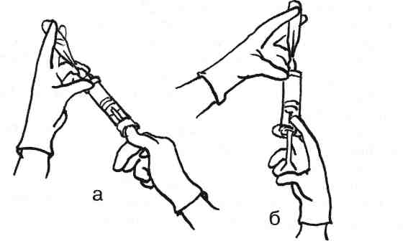
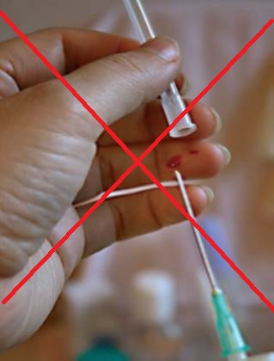

Slide 38
Intradermal Injection
Definition: It is an injection given into the dermal layer of the skin (corneum).
Purpose:
For diagnostic purpose:
a) Fine test (mantoux test);
b) Allergic reaction
For therapeutic purpose: Intradermal injection may also be given like in vaccination.

Slide 39
Site of injection:
The inner part of the forearm (midway between the wrist and elbow).
Upper arm, at deltoid area for BCG vaccination

Slide 40
Intradermal Injection
Definition: It is an injection given into the dermal layer of the skin (corneum).
Purpose:
For diagnostic purpose:
a) Fine test (mantoux test);
b) Allergic reaction
For therapeutic purpose: Intradermal injection may also be given like in vaccination.
Site of injection:
The inner part of the forearm (midway between the wrist and elbow).
Upper arm, at deltoid area for BCG vaccination
Equipment. Sterile: disposable syringes with a medicine , 2 needles length 15 mm, tray, 3 napkins or 3 cotton swabs (balls). Antiseptic for processing of injection’s area (70% spirit), gloves, tray, container for disinfection / disposal of used material (waste class A, Б).
Algorithm of actions:
Prepare the equipment. Preparation medicines (take out from an ampule/ see above the algorithm).
Identify the patient: Check the room number etc. Call the patient by name in a questioning manner. Ask the patient to repeat the name. Ask someone who knows the patient.
Explain to the patient the purpose and procedure course. Obtain patient's consent.
Be convinced in the absence of allergy on medicines.
Offer to the patient to take a comfortable position. Select and examine the site of injection.
Clean the skin (a large area) with first cotton ball moistened by antiseptic in one direction. Put his in the container for waste class Б.
Clean the skin (a small area - site of injection) with second cotton ball moistened by antiseptic in one direction. Put his in the container for waste class Б
Take the syringe in the right hand (dominant hand) holding the needle's cannula by forefinger.
Remove cap. Put his in the container for waste class Б.
Take forearm by left hand from below, stretch the skin on the inner surface of the middle one third of the forearm.
Hold the needle almost parallely to the skin (at an angle 10-15 °)
Enter (Insert) in the skin only the tip of the needle bevel up.
Place the fingers of left hand on the piston of the syringe. Slowly introduce the medicine to appearance papules.
Remove the needle without pressing to the injection site by cotton ball with antiseptic.
Take off the gloves and put them in the container for waste class Б.
Wash hands hygienic way.
Make a record of results in a medical documentation.

Slide 41
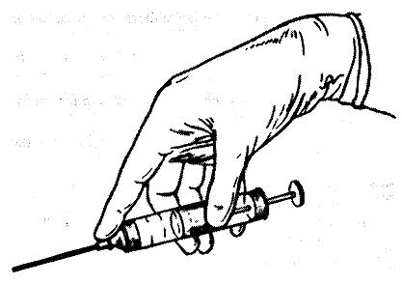
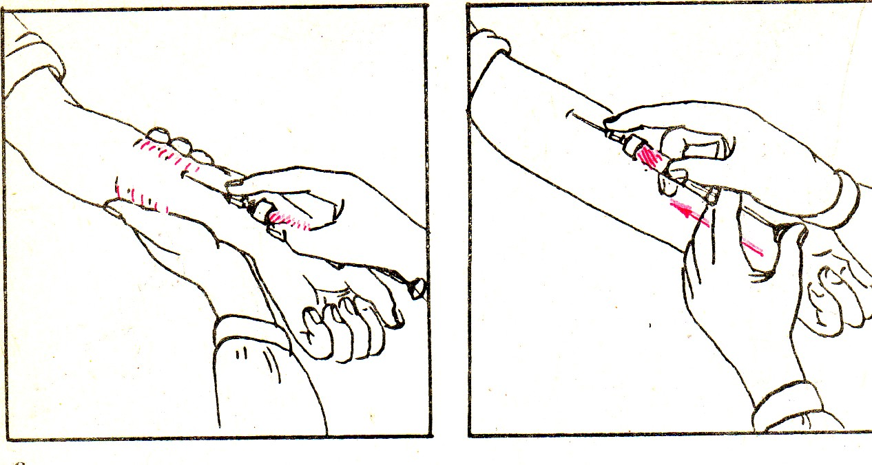
Intradermal Injection. Correct position of the syringe in the hand

Slide 42
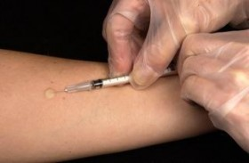

Slide 43
Subcutaneous Injection
Definition: Injecting of drug under the skin in the sub - cutaneous tissue, (under the dermis)
Site of injection:
Outer part of the upper arm
The abdomen below the costal margin to the iliac crest.
The anterior aspect of the thigh
The suprascapular site.
upper ventral or dorsogluteal area

Slide 45
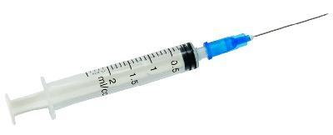
Syringe for subcutaneous injection
The volume of the used syringe - 2 ml
Needle - 30 mm

Slide 46
Subcutaneous Injection
Definition: Injecting of drug under the skin in the sub - cutaneous tissue, (under the dermis)
Purpose:
To obtain quicker absorption than oral administration
When it is impossible to give medication orally
Site of injection:
Outer part of the upper arm
The abdomen below the costal margin to the iliac crest.
The anterior aspect of the thigh
The suprascapular site.
Equipment. Sterile: disposable syringes (a volume of 1-5 ml), 2 needles length 30 mm, tray, 4 napkins or 4 cotton swabs (balls). Antiseptic for processing of injection’s field (70% spirit), gloves, container for disinfection / disposal of used material (waste class A, Б).
Algorithm of actions:
Prepare the equipment. Preparation medicines (take out from an ampule/ see above the algorithm).
Identify the patient: Check the room number etc. Call the patient by name in a questioning manner. Ask the patient to repeat the name. Ask someone who knows the patient.
Explain to the patient the purpose and procedure course. Obtain patient's consent.
Be convinced in the absence of allergy on medicines.
Offer to the patient to take a comfortable position. Select and examine the site of injection.
Clean the skin (a large area) with first cotton ball moistened by antiseptic in one direction. Put his in the container for waste class Б.
Clean the skin (a small area - site of injection) with second cotton ball moistened by antiseptic in one direction. Put his in the container for waste class Б.
Third cotton ball is pressed to the left palm with little finger.
Take the syringe in the right hand (dominant hand) holding the needle's cannula by forefinger.
Remove cap. Put his in the container for waste class Б.
Remove cap, put in the container for waste class Б.
Make the skin fold with left hand. Grasp the area between your thumb and forefinger to tense it. Fold should be triangular form base down.
Hold the needle bevel up. Rapid motion insert the needle at an angle of 45 degrees. On 2/3 the length of the needle.
Perform the aspiration test: Place the fingers of left hand on the piston of the syringe. Draw back the piston (plunger) to check whether or not you are in the blood vessel (if blood returns, with draw and get a new needle & reinject in a different spot).
Inject the drug slowly.
After injecting remove the needle, pressing the third cotton antiseptic ball to the site of injection. Put his in the container for waste class Б.
Take off the gloves and put them in the container for waste class Б.
Wash hands hygienic way.
Make a record of results in a medical documentation.

Slide 47
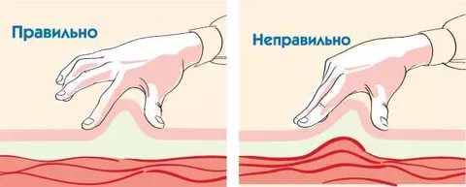
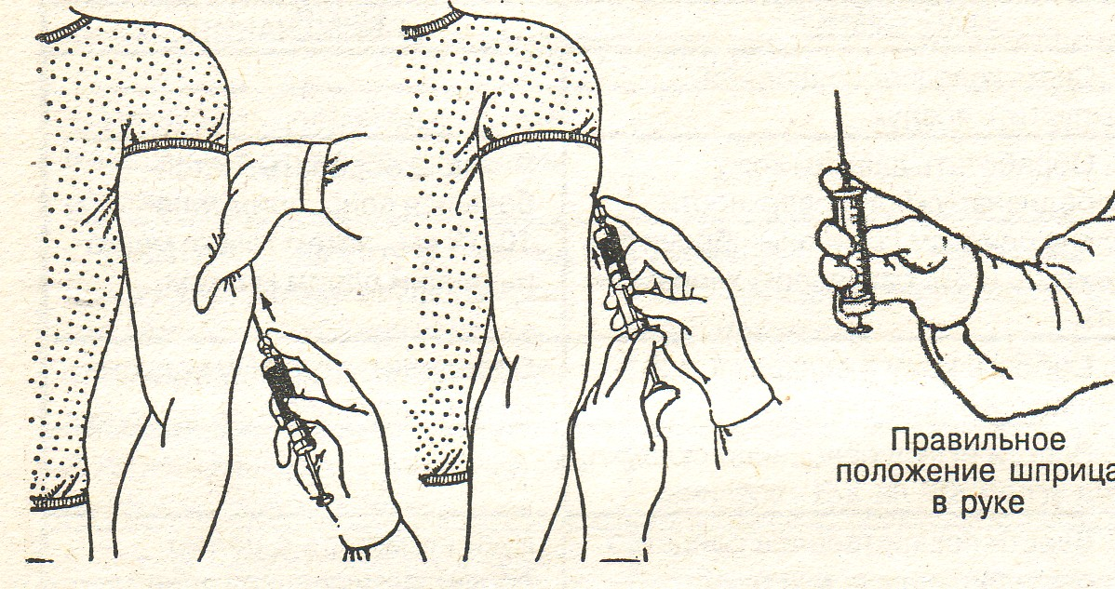
Subcutaneous injection. Correct position of the syringe in the hand

Slide 48
Subcutaneous route of administration of drugs is used when you want a slow, steady absorption of drug in the blood. For this purpose, 1-2 ml of drug is injected under the skin. This route of administration is ideal for such drugs as insulin, which requires uniform release.

Slide 49
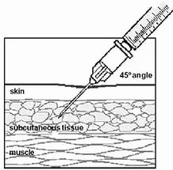
Traditionally, subcutaneous injection is carried out by the puncture of needle at an angle of 45 degrees into the skin fold. however, with the introduction of shorter insulin needles, insulin injections are now recommended to perform with the puncture needle at an angle of 90 degrees.

Slide 50
INTRAMUSCULAR INJECTION
Muscles have a wider network of blood and lymphatic vessels, which creates conditions for rapid and complete absorption of drugs.
To perform intramuscular injections in certain areas of the body where there is a considerable layer of muscle tissue and do not pass near large vessels and nervous trunks.

Slide 51
Intera-Muscular Injection
Definition: It is an introduction of a drug into a body's system via the muscles.
Injection area:
the upper external quadrant of the buttocks,
the deltoid,
wide lateralis muscle thigh.

Slide 52
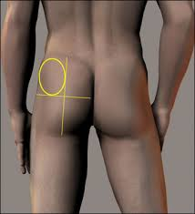
The injection site of intramuscular injections THE GLUTEAL REGION
For intramuscular injection in the gluteal region used only its upper outer part. This is due to the anatomical structure of the human body. This is the safest place possible to perform intramuscular injections. It should be remembered that accidental exposure to a needle in the sciatic nerve can cause partial or complete paralysis of the limbs. It is also close to a bone (sacrum) and the large vessels. In patients with flabby muscles, this place is localized very difficult.

Slide 53
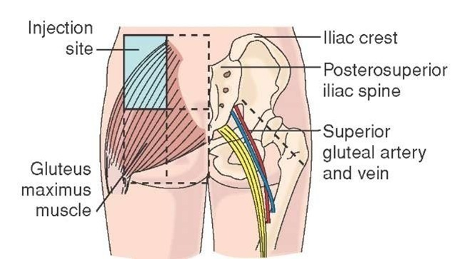

Slide 54
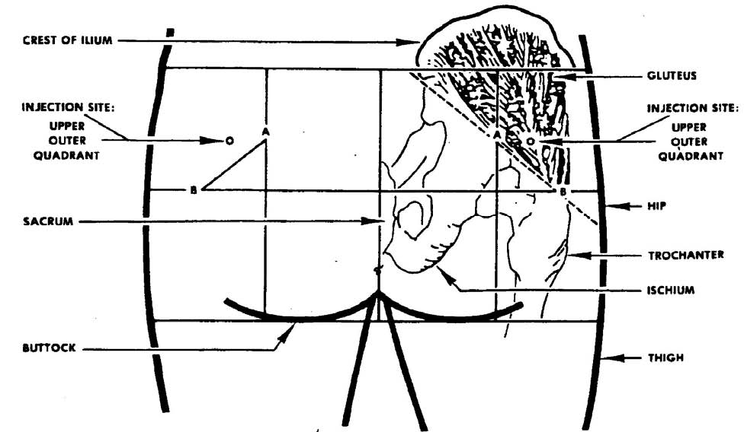
Lay the patient on either the abdomen (toes turned inward) or side (leg that will be on top, bent at the hip and knee to relax the gluteal muscle). Feel the following anatomical structures: upper rear iliac spine and the greater trochanter of the femur.

Slide 55
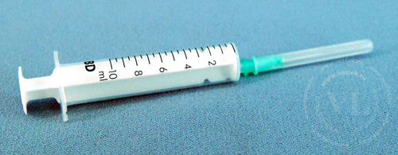
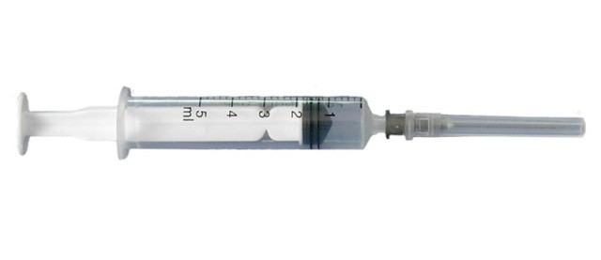
Syringe for intramuscular injections
The volume of the used syringe -5 ml, 10 ml
Needle - 40 mm

Slide 56
Intera- Muscular Injection
Definition: It is an introduction of a drug into a body's system via the muscles.
Purpose:
To obtain quick action next to the intra- venous route
To avoid an irritation from the drug if given through other route.
Injection area: the upper external quadrant of the buttocks, the deltoid, wide lateralis muscle thigh.
Equipment. Sterile: disposable syringes (a volume of 5-10 ml), 2 needles length 40 mm, tray, 4 napkins or 4 cotton swabs (balls). Antiseptic for processing of injection’s field (70% spirit), gloves, container for disinfection / disposal of used material (waste class A, Б).
Algorithm of actions:
Prepare the equipment. Preparation medicines (take out from an ampule).
Identify the patient: Check the room number etc. Call the patient by name in a questioning manner. Ask the patient to repeat the name. Ask someone who knows the patient.
Explain to the patient the purpose and procedure course. Obtain patient's consent.
Be convinced in the absence of allergy on medicines.
Offer to the patient to take a comfortable position. Choose the site of injection. Using the iliac crest as the upper boundary divided the buttock into four.
Clean the skin (a large area) with first cotton ball moistened by antiseptic in one direction. Put his in the container for waste class Б.
Clean the skin (a small area) with second cotton ball moistened by antiseptic in one direction. Put his in the container for waste class Б.
Third cotton ball is pressed to the left palm with little finger left hand.
Take the syringe in the right hand (dominant hand) holding the needle's cannula by little finger.
Remove cap. Put his in the container for waste class Б.
Stretch the skin with thumb and forefinger of the left hand (at the child and the old man seize muscle; this increases mass of muscle and facilitate the introduction of a needle).
Rapid motion insert the needle at an angle of 90 degrees. On 2/3 the length of the needle.
Perform the aspiration test: Place the fingers of left hand on the piston of the syringe. Draw back the piston (plunger) to check whether or not you are in the blood vessel (if blood returns, withdraw and get a new needle & reinject in a different spot).
Push the drug slowly into the muscle.
After injecting remove the needle, pressing the third cotton antiseptic ball to the site of injection.
Take off the gloves and put them in the container (waste class Б).
Wash hands hygienic way.
Make a record of results in a medical documentation.

Slide 57
Elderly and malnourished patients have less muscle mass than younger people, so before you perform an intramuscular injection should be assessed whether it is enough for this muscle mass. If the patient has little muscle, you must take the muscle in the crease prior to injection.
The estimated injection site should be examined for signs of inflammation, edema and infection, it is necessary to avoid the introduction of the drug into the areas of damaged skin.
2-4 hours after injection, inspect the place and make sure there are no unwanted effects.

Slide 58
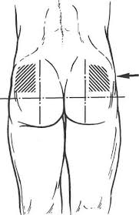
With repeated injections should be alternated right and left sides, to change places of injection: this reduces the pain from the procedure and prevent complications.

Slide 59
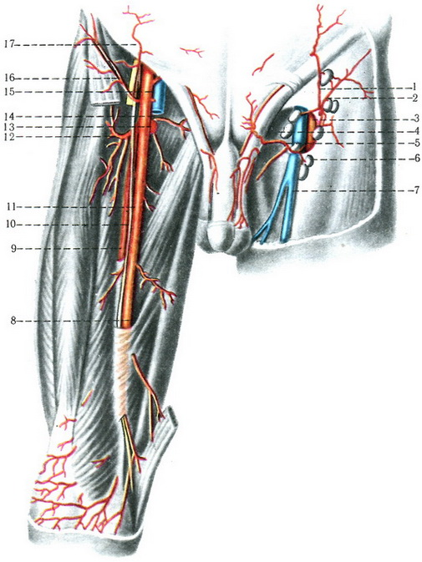
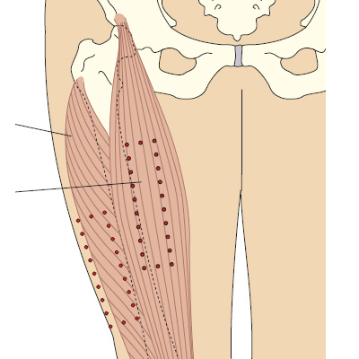
The injection site of intramuscular injections LATERAL VASTUS

Slide 60
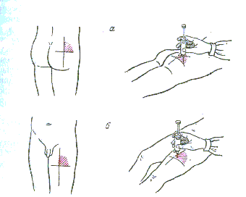
Place the right hand about 1-2 cm below the trochanter of the femur, left - 1-2 cm above the patella, the thumbs of both hands should be on one line. Determine the injection site, which is located in the center of the area formed by the forefingers and thumbs of both hands.

Slide 61
INTRAVENOUS INJECTION
Intravenous injections provide the introduction of the drug directly into the bloodstream. The main condition in this method of administering medicines is strict compliance with the rules of asepsis (washing and treatment of the hands, the skin of the patient, etc.).

Slide 62
Intravenous injections
Definition: It is the introduction of a drug in solution form into a vein. Often the amount is not more than 10.ml. at a time.
Sites for injection:
1. Dorsal Venous network
2. Dorsal metacarpal Veins
3. Cephalic Veins
4. Radial vein
5. Ulnar vein
6. Baslic vein
7. Median cubital vein
8. Greater saphenous vein

Slide 63
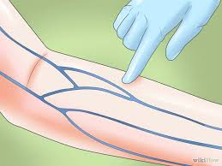
Subcutaneous vein of the upper limb - radial and ulnar saphenous vein. Both these veins, connecting over the entire surface of the upper limb, form lots of compounds, the largest of which - the middle vein of the elbow, most commonly used for venepuncture.
For intravenous injections, the most commonly used veins of the cubital fossa, because they have a large diameter, are relatively superficial and little shifted.

Slide 64
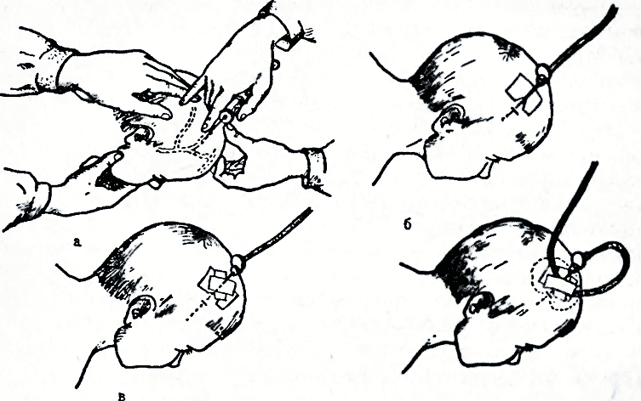
In infants and young children for venipuncture veins used heads that they have well-defined, as veins of the extremities are very thin and difficult to puncture.

Slide 65
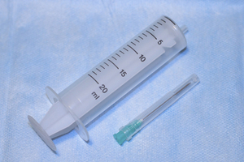
Syringe for Intravenous injections
The volume of the used syringe – 10 ml, 20 ml
Needle - 40 mm

Slide 66
Intravenous injections
Definition: It is the introduction of a drug in solution form into a vein. Often the amount is not more than 10.ml. at a time.
Sites for injection: 1. Dorsal Venous network 2. Dorsal metacarpal Veins 3. Cephalic Veins 4. Radial vein 5. Ulnar vein 6. Baslic vein 7. Median cubital vein 8. Greater saphenous vein
Purpose
When the given drug is irritating to the body tissue if given through other routes.
When quick action is desired.
When it is particularly desirable to eliminate the variability of absorption.
When blood drawing is needed (exsanguinations)
Equipment. Sterile: disposable syringes with a medicine (a volume of 10-20 ml), 2 needles length 40 mm, tray, 4 napkins or 4 cotton swabs (balls). Antiseptic for processing of injection’s field (70% spirit), venous tourniquet, oilcloth pillow, bandage, gloves, container for disinfection / disposal of used material (waste class A, Б).
Algorithm of actions:
Prepare the equipment. Preparation medicines (take out from an ampule).
Identify the patient: Check the room number etc. Call the patient by name in a questioning manner. Ask the patient to repeat the name. Ask someone who knows the patient.
Explain to the patient the purpose and procedure course. Obtain patient's consent.
Be convinced in the absence of allergy on medicines.
Offer to the patient to take a comfortable position. Choose the site of injection. When performing injection in the area of cubital fossa - offer to the patient to straighten the arm at the elbow maximally.
Put under the patient's elbow oilcloth pillow. Place oilcloth and towel under his arm (to protect the bed linen) if a nurse makes an injection into the ward.
Expose the arm and apply venous tourniquet (on a shirt or a diaper) on the lower one third of the arm that the radial pulse is palpated.
Ask the patient: «To open and close his fist». Palpate the vein.
Clean the skin (a large area) with first cotton ball moistened by antiseptic in one direction (put in class Б waste).
Clean the skin (a small area - site of injection) with second cotton ball moistened by antiseptic in one direction (put in class Б waste).
Third cotton ball is pressed to the palm with little finger.
Take the syringe in the right hand (dominant hand) holding the needle's cannula by forefinger.
Remove cap. Put them in the container for waste class Б.
Fixing the vein with thumb.
Hold the needle bevel up. Parallely to the skin, puncture a vein, then insert the needle into the vein at an angle of 15° (on 1/2 length of the needle).
Perform the aspiration test: Place the fingers of left hand on the piston of the syringe. Draw back the piston (plunger) to check whether you are in the vein or not. (Blood return should be seen if you are in the vein). Once you know that you are in the vein, release the tourniquet.
Again draw back the piston to check whether you are in the vein or not.
Inject the drug slowly.
After injecting remove the needle, pressing the third cotton antiseptic ball with to the site of injection.
Apply pressure over the injection site after removing the needle to prevent bleeding. Tell patient to flex his elbow.
Watch the patient for few minutes before leaving him.
Take off the gloves and put them in the container for waste class Б.
Wash hands hygienic way.
Make a record of results in a medical documentation.

Slide 67
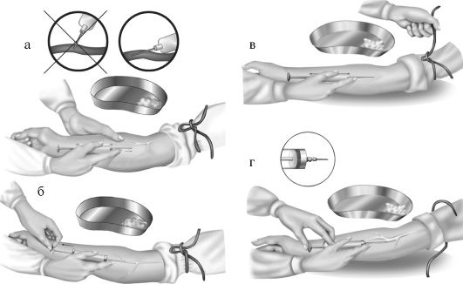

Slide 68
Factors complicating intravenous injection:
excitement and fear of the patient;
cold;
re-puncture;
veins sclerotic changes in patients of elderly and senile age;
thin veins ( women and children);
a "floating" veins;
dehydration;
Shock (low blood pressure);
long-term use of steroids;
cachexia.

